Slide 1
The Importance of advertising in money remittance services
Presented by Whitney

Slide 2
Table of Contents
Introduction
The Client’s Dilemma
Objective
Data Collection
Analysis
Data Insights

Slide 3
Introduction
Money remittance services play a pivotal role in facilitating financial transactions across borders
Money remittance refers to the process of sending money from one person or location to another.
Why does Advertising matter to money remittance service?
Advertising serves as the way through which money remittance services communicate their value propositions and reliability to the target audience.
It is the vehicle that conveys the essence of these services, creating brand awareness and influencing the decision-making process of users

Slide 4

The Client’s Dilemma
Which type of Advertising Channel(s) should I consider to give me the best possible returns?

Slide 5
Objective
Are there specific demographic segments more responsive to certain advertising channels?
.
How do different advertising channels (online, traditional, mixed media) influence customer awareness in money remittance services?
To communicate the pivotal role that advertising plays in fostering customer trust, and driving overall business growth

Slide 6
Data Collection
Features
-Customer demographics
-Awareness of advertisements
-Preferred advertising channels
Survey Method

Slide 7
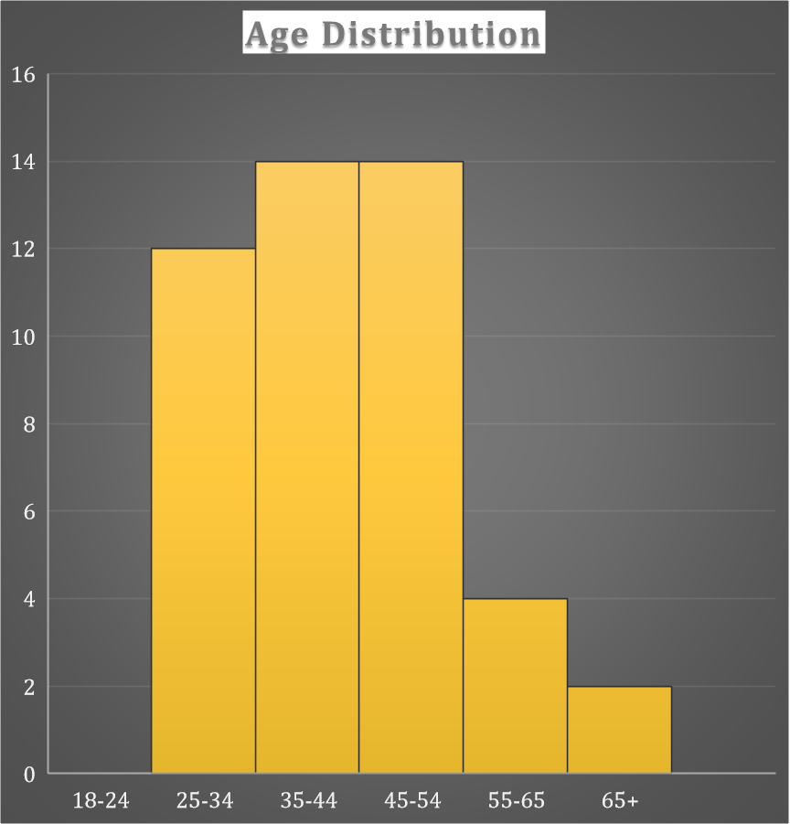
Customer Demographics
43% represent Females
57% represent Males
Total Respondents:46

Slide 8


Slide 9



My definitions of the various channels
Online media: social media channels , website, apps;
Traditional media :word of mouth
Mixed media : Television, Radio, SMS,Online etc.

Slide 10
Advertising Channels

Slide 11
.

Slide 12

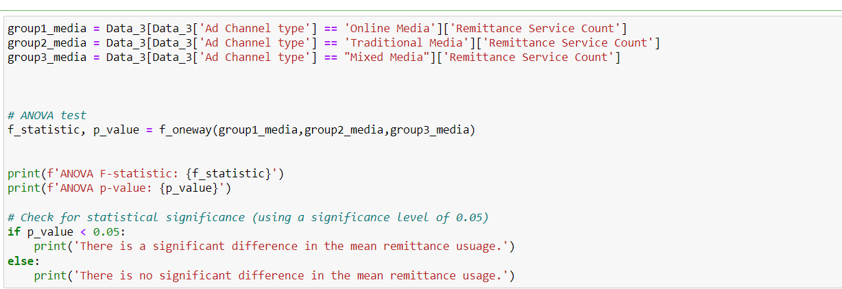
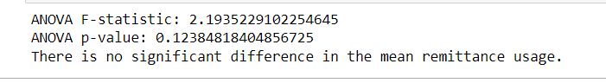
Hypothesis testing
Ho: Does the choice of ad channel type increase the remittance service count?

Slide 13
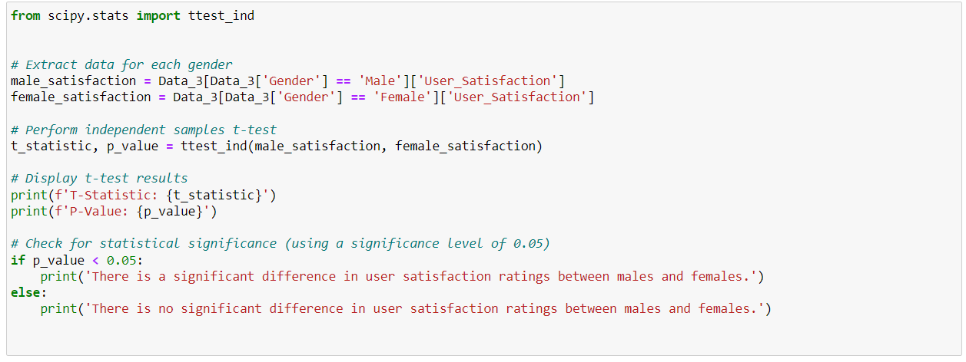
Hypothesis testing
Ho: There is no difference in user satisfaction ratings between males and females.

Slide 14
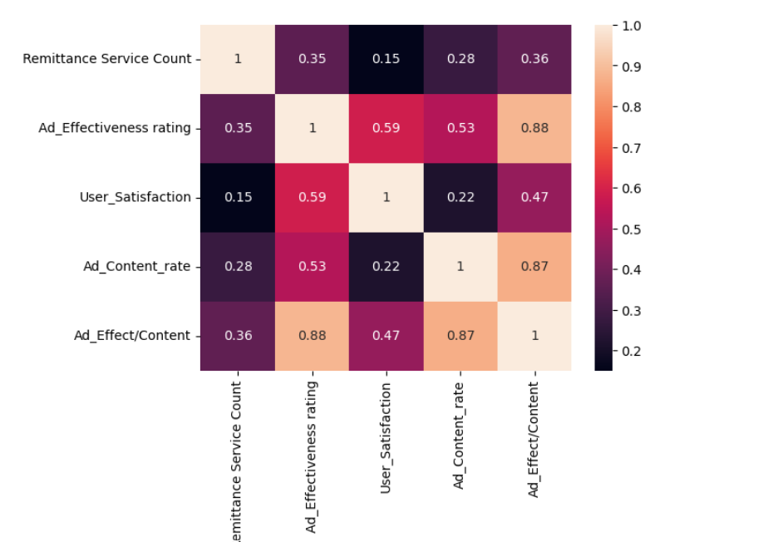
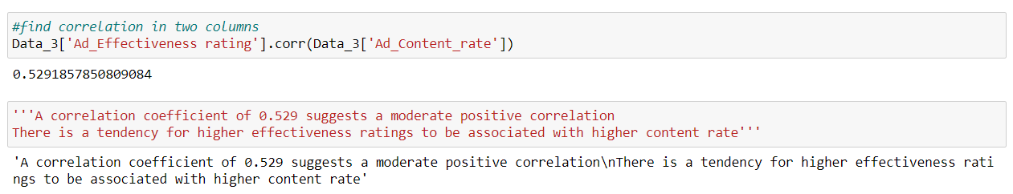
Correlation
A correlation coefficient of 0.88 suggests a positive correlation
There is a tendency for higher effectiveness ratings to be associated with higher content rate

Slide 15

Data Insights and Recomendation
56% remitters are exposed to many ads via Online (Social media, etc)
34% are exposed to these ads daily
40% are exposed to these ads weekly
To reach a wider target audience, online marketing is highly recommended!!

Slide 16
Limitations
Sampling bias

Slide 17
Thank you

